Slide 1
Multi-Scale Rendering of Scratched Materials using a Structured SV-BRDF Model
- Proposed by
Boris Raymond, Gaël Guennebaud, Pascal Barla (SIGGRAPH 2016)
- Presentation by
Bhavy Bhut (810917417)

Slide 2
Introduction
SV-BRDF (Spatially Varying BRDF model)
This model used for scratched materials such as metals, plastics or finished woods.
Traditionally in computer graphics, opaque materials represented using Bidirectional Reflectance Distribution Function (BRDF)
Real world materials are not homogeneous, it often exhibit micro variations in reflectance or geometric details.
SV-BRDF model accounts all inter-reflections inside a scratch, including Fresnel effects (The observation that the amount of reflectance you see on a surface depends on the viewing angle).
Bhavy Bhut

Slide 3
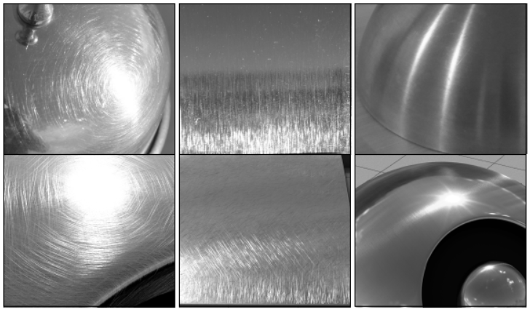
Introduction
Scratches usually distributed all over the surface.
It produces various visual effects like, glint lines, patterned highlight and directionally smeared reflections.
Bhavy Bhut

Slide 4
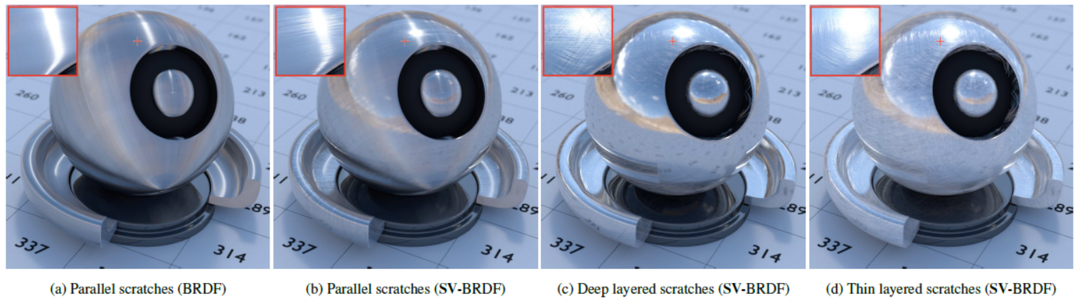
Introduction
Reflections from scratches has a visible impact on appearance.
Scratch layer: set of similar parallel scratches
Scratch distribution: combination of one or more layers.
Bhavy Bhut

Slide 5
Previous models
Distribution based models
Determined by normal distribution function (NDF)
It only consider single scattering
NDF valid only when number of scratches fall below pixels
Data driven models
Bidirectional Texture Function (BTF)
Requires costly precomputations and large memory; limiting angular resolution too much for scratched materials
Ignores inter-reflections inside scratches
Primitive based models
Modeling materials based on distributions of small primitives (micro-cylinders)
Ignored inter-reflections and micro-geometry never visible
Cloth rendering
Bhavy Bhut

Slide 6
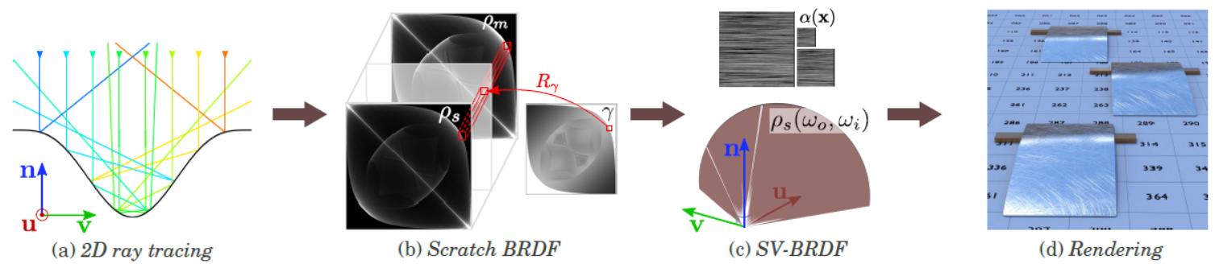
SV-BRDF model
Assume the base surface is locally flat, with scratches in a same layer running straight and parallel to each other
First consider mirror scratch BRDF
Bhavy Bhut

Slide 7
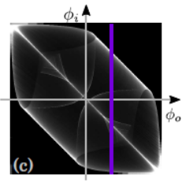
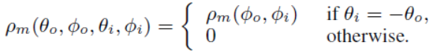
Mirror scratch BRDF
Each scratch considered independently of others
o and i refers to outgoing and incoming directions
Subscript m stands for mirror
For each discrete value of Ø_{i}, shoot N rays at random positions over a scratch, perform recursive ray-tracing with mirror reflection within the scratch until the ray exits the scratch with a direction Ø_{o}.
Bhavy Bhut

Slide 8
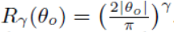
Full scratch BRDF
Real world materials are not prefect mirror
This includes Fresnel effects inside scratch (reflection and refraction)
Full scratch BRDF with Fresnel effect is approximated using below formula (ensures energy conservation)
Approximation does not require to simulate full 3D scratch BRDF; only 3 slices at θo = {0, π/3, π/2} need to be computed
Where is reflectance curve function
Bhavy Bhut

Slide 9
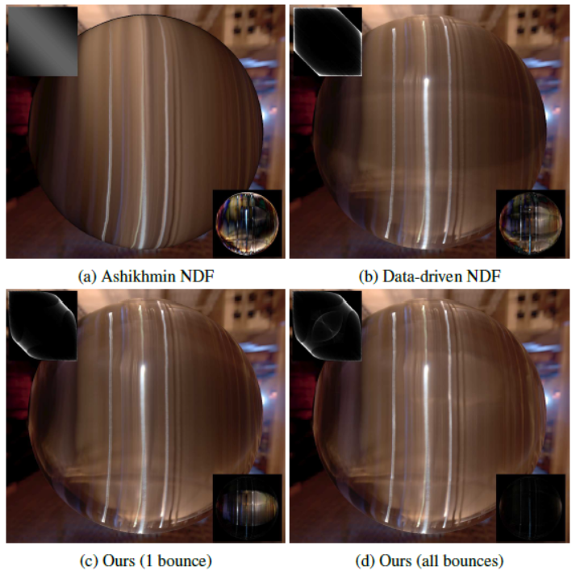
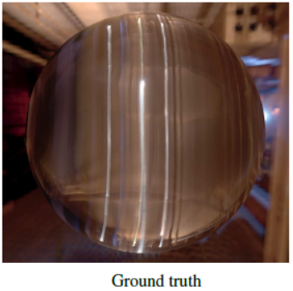
Full scratch BRDF Comparison
Scratch BRDF, even when limited to single bounce, is superior to other models. It is nearly indistinguishable from the ground truth.
Bhavy Bhut

Slide 10
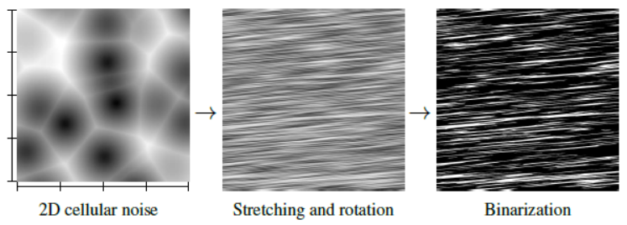
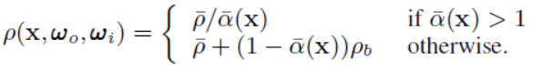
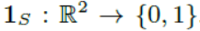
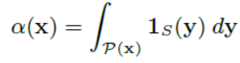
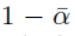
Spatially Varying BRDF
Full scratch BRDF used to model uniform materials with parallel scratches
In realistic look has variations in spacing, width, height and orientation of scratches
SV-BRDF formula,
Where 1_{s} is indicator function
α is relative area of scratches
represents ratio of scratch free surface
Image shows how 1_{s} indicator function is applied
Discards k-th layer if α_{k} < 10⁻⁶
Bhavy Bhut

Slide 11
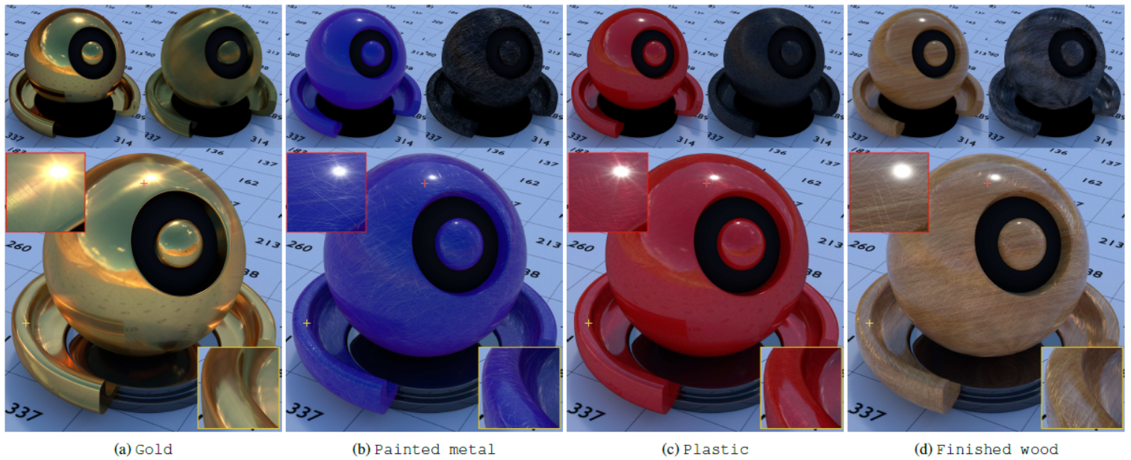
Global illumination results
Top row: separate appearance of base and scratch materials
Bottom row: combined result
Showing result of Gold (4 layers), Painted Metal (16 layers), Plastic (32 layers) and Finished wood (16 layers)
Bhavy Bhut

Slide 12
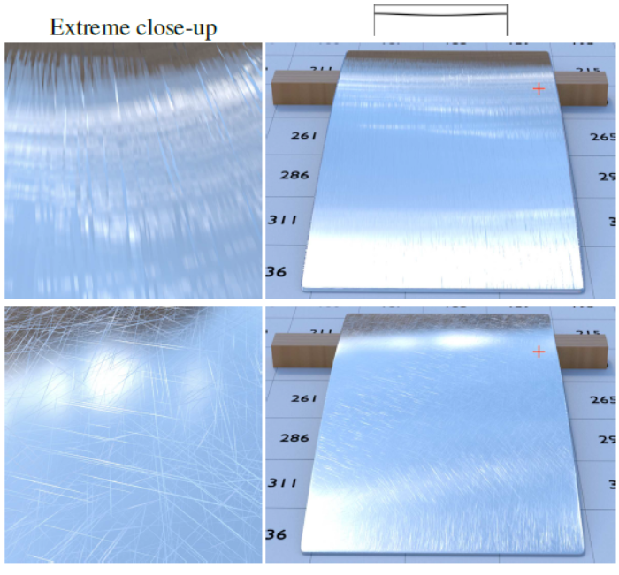
Limitations
SV-BRDF not guaranteed to conserve energy.
Failed to handle bulges that stick out of the base surface. SV-BRDF scratches are only dug in side.
Not able to handle extreme close up views where scratch is significantly wider than a pixel.
Not considered scratched transparent materials such as glass
Bhavy Bhut

Slide 13
Future work
Handle extreme close up views
Increase visual richness by handle all scratch parameters (profile, width, height etc) vary per layer
Enhance scratch BRDF model that could be instanced on the fly, instead of running a simulation per scratch profile in preprocess
Bhavy Bhut

Slide 14
Conclusion
SV-BRDF reproduce high-frequency spatial and angular scratched materials without heavy computation and memory resources.
Scratched materials designed at interactive rates with fast feedback and in global illumination rendered with realistic look.
A benefit is that this approach can easily integrated in existing rendering packages and extensible to new scratch profiles.
Bhavy Bhut

Slide 15


Slide 16


